Slide 1

University Institute of Liberal Arts and Humanities
Course Name: Communication Skills
Course Code: 23PCH-105
Barriers to Effective Communication
DISCOVER . LEARN . EMPOWER

Slide 2
COURSE OBJECTIVES
The Course aims to:
1 | Augment students overall communication and interpersonal skills by making them realize the importance of good oral and written English Language in professional life.
2 | Enrich their reading capability with special emphasis on expanding vocabulary and grammatical formations.
3 | Build exceptional speaking, reading and writing skills by correcting grammatical errors and pronunciation through practice.
4 | Enhances soft skills by fostering self awareness, confidence and a positive attitude in students’ ability to communicate effectively in English.

Slide 3
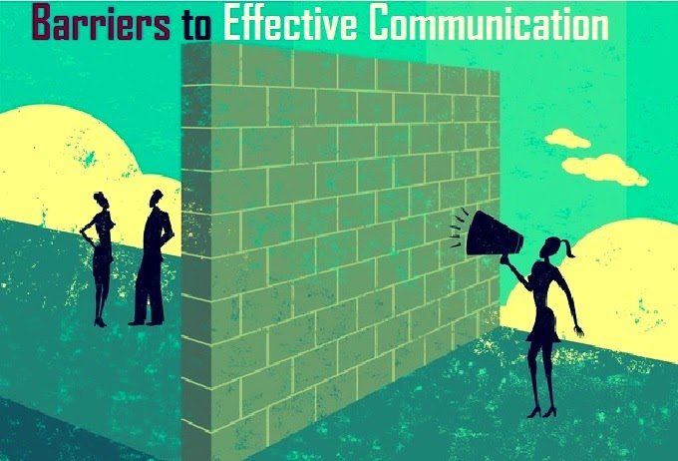
Course Outcomes
On completion, the students are expected to:
CO Number | Title | Level
CO1 | Apply appropriate Listening, Speaking, Reading and Writing Skills (LSRW Skills) with correct non-verbal cues to attain expertise in soft skills. | Apply
CO2 | Apply correct contextual and comprehensible written text in the form of paragraph writing, short compositions business correspondence, using logical support and argument in a wide range of communication situations. | Apply
CO3 | Demonstrate linguistic competence while speaking and during presentations through accuracy in grammatical usage, vocabulary, pronunciation and intonation. | Apply
CO4 | Evaluate information as critical readers, speakers and writers applying ethics in communication and being sensitive in cross cultural communication. | Evaluate
CO5 | Create original, digital content for websites, blogs, vlogs and personal social media profiles etc. | Create
https://www.scientificworldinfo.com

Slide 4

"If you improve your communication skills, I guarantee you that you will earn fifty percent more money over your lifetime.”
~ Warren Buffett
weebly.com

Slide 5
A Case: Who wants the divorce?
A judge was interviewing a woman regarding her pending divorce, and asked, “What are the grounds for your divorce?”
She replied, “About four acres and a nice little home in the middle of the property with a stream running by.”
“No, I mean,” he continued, “What are your relations like?”
“I have an aunt and uncle living here in town, and so do my husband’s parents.”
Source: http://www.thehumorsource.com/item/33064

Slide 6
A Case: Who wants the divorce?
“Ma’am, does your husband ever beat you up?”
“Yes,” she responded, “about twice a week he gets up earlier than I do.”
Finally, in frustration, the judge asked, “Lady, why do you want a divorce?”
“Oh, I don’t want a divorce,” she replied. “I’ve never wanted a divorce. My husband does. He said he can’t communicate with me.”
Source: http://www.thehumorsource.com/item/33064

Slide 7
What Are Barriers?
A problem, external or internal, that causes our communication to be distorted is known as a barrier to effective communication.
External barriers are caused by external factors such as noise, network issues etc
Internal barriers are mental or psychological blocks which affect the communication process.

Slide 8
Categories Of Barriers
Arising from Sender/ Receiver’s Personality
Psychological
Perceptional
Related To Interpersonal Transactions
Limited Frame Of Reference
Emotional Interference
Related To Organizational Network
Organizational Policy
Technological Barriers
Physiological Barriers

Slide 9
Arising From Sender Or Receiver’s Personality
These barriers are governed by:
Difference in perception
Rigidity in thoughts
Distrust
Sender and receiver’s attitude
Socio-cultural background
Behaviour
Lack of attention

Slide 10
Categories Of Personality Related Barriers
Arising from Sender/ Receiver's personality
Psychological
Perceptional

Slide 11
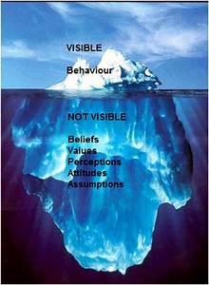
Arising From Sender Or Receiver’s Personality
The personality of an individual is shaped by
Psychology ie. the science of human behavior.
Consequences of such barrier can be:
Lack of attention
Distrust
Lack of retention
Perception
Thoughts
https://tse4.mm.bing.net/

Slide 12
Tips To Overcome The Barrier
Develop empathy and flexibility
Provide positive criticism
Create mutual understanding
Maintain positive body language
Avoid stereotyping

Slide 13
Poll Question 1
Perception and psychology shapes the personality.
True
False

Slide 14
Related To Interpersonal Transactions
Interpersonal transaction refers to relationship between sender and receiver, subordinate and superior, management and employees.
Major factor resulting in this barrier
Employees’ frame of reference
Language skills
Semantics
Cultural background
Emotional quotient

Slide 15
Categories Of Interpersonal Transactions
Interpersonal Transactions
Frame of Reference
Emotional Interference
Semantics
Cultural Background

Slide 16
Frame Of Reference
Semantic Barriers
Use of jargon
Symbols and words with different meanings
Cultural Barriers
Cultural norms
Badly expressed message
Religion
Nationalities

Slide 17
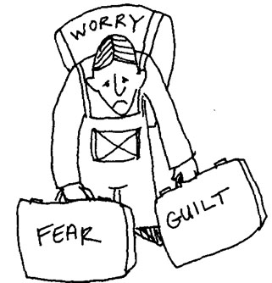
Emotional Interference
Emotional barriers to communication are generally due to insufficient emotional awareness or control.
Major emotional factors that interfere in communication are:
Anger
Worry
Pride
Anxiety
Stress
Low self-esteem.
http://www.adrtoolbox.com/

Slide 18
Tips To Overcome
Use body language sparingly
Avoid using jargons
Respect the dissimilarities
Avoid commenting about culture
Maintain work-life balance

Slide 19
Poll Question 2
________________ helps to overcome cultural barrier.
Maintaining work life balance
Use proper language
Respect the dissimilarities

Slide 20
Organizational Barriers
Most of the barriers affecting the communication in workplace can be categorised under organisational barriers.
These are related to:
Technological Issues
Physiological Barriers
Rules and Regulations
Organisation’s Policy
Channel of communication

Slide 21
Categories Of Organisational Barriers
Organizational Barriers
Organizational Policy and Facility
Physiological Barriers
Technological Barriers

Slide 22
Organisational Policy And Facilities
Proper organisational facilities such as complaint box, suggestion box, social and cultural gathering are very important for the proper flow of communication.
If the free flow of communication is not provided in organisational policy, it leads to the barriers to communication.
Various factors resulting in the barriers are:
1. Hierarchal relationship 2. Lack of incentive
3. Attitude of superiors 4. Lack of awareness

Slide 23
Physiological Barriers
This is categorised under external barriers
Physiological barriers include problems related to sender or receiver’s physical state and disturbances caused by the external factors.
Some of the main physical/physiological barriers are:
Environment
Distance
Medium

Slide 24
Technological Barriers
Various technological equipments give precision in result and save our time and energy. But, if not implemented properly it can prove useless as well
Reasons behind technical barriers are:
Improper training
Limited resources
Lack of innovation etc.

Slide 25
Tips To Overcome
Maintain cordial relations
Choose proper medium
Choose proper channel
Avoid sending long messages
Use concrete words

Slide 26
Poll Question 3
Time, place, space, climate are the examples of_____________
Psychological Barriers
External Barrier
Physiological Barrier
Environment Barrier

Slide 27
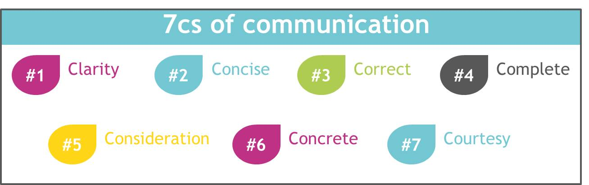
7 Cs of Effective Communication
Seven important factors that can result in effective communication are:
https://4.bp.blogspot.com/

Slide 28
Applications
To communicate effectively at workplace
Introspect the reason behind the ineffective communication
To get a fair idea about which barrier is causing ineffective communication.
Overcome various barriers to communication by using various tips.
Apply 7Cs to make proper communication.

Slide 29
Assessment Pattern
Students are assessed on the basis of the following parameters:
Hourly Tests - 2
Assignments
Surprise Test
Quiz
Student Engagement
End Semester Exam

Slide 30
References
https://nptel.ac.in/courses/109/104/109104030/
https://www.yourarticlelibrary.com/business-communication/barriers-to-business-communication-business-management/70120
https://www.researchgate.net/publication/323794732_Barriers_to_Effective_Communication
https://www.lifehack.org/593804/barriers-to-communication
https://www.skillsyouneed.com/ips/barriers-communication.html

Slide 31
THANK YOU
For queries
Email: communicationskills.uilah@gmail.com

